Slide 1
R package to calculate toxicity grade
Dan Li
March 2025

Slide 2
Index
- Introduction
Main consideration and solution
Implementation
Limitations & possible improvements
Q&A
Notes:
大家上午好，很高兴来Pharma RUG 2025。上一位演讲者讲得非常精彩，我要讲的内容比较简单。首先介绍一个这个R package的背景，我是从哪里开始的。然后介绍一下要解决的问题是什么，主要考虑的是什么，解决方案是什么。最后用图示介绍一下具体是怎么实现的，以及这个实现的局限性和未来可能的改进。

Slide 3
Introduction

Slide 4
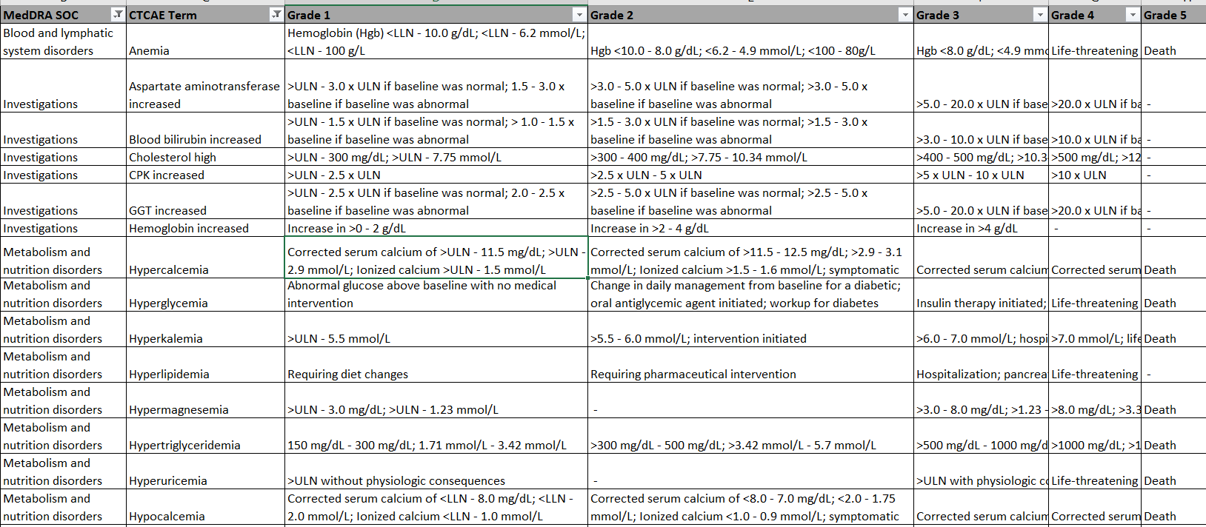
Introduction
Laboratory results can be classified into severity (toxicity) grades based on the National Cancer Institute (NCI) Common Terminology Criteria (CTC) for Adverse Events. Currently NCI document versions 4.03 and 5.0 can be used to assign grades.
We included each specified unit possibility + our Merck internal standard units
Corrected Serum Calcium or ionized Calcium. Corrected serum Calcium needs to be derived in Database. Ca alone cannot be assessed
Some medical text is possible to assess. Resolves to >Normal range and > Baseline „with no medical intervention“ is ignored
Medical assessments not possible to assess, ignored
Ignored the physiological consequences, took >ULN
Notes:
这是NCI CTC AE文件的一部分，引用自一位SME同事，她是这方面的专家。可以看到对应于某个term, 满足不同的条件就会得到不同的toxicity或者说severity grade。理想的情况是对照这个文件直接使用。
但实际使用起来有一些困难，比如图上指出的medical assessment无法测量应该忽略，单位需要转换，等等。

Slide 5
The NCI CTCAE files
It is difficult to use NCI CTC AE file to derive toxicity grade directly for several reasons:
Sometimes medical assessments and physiological consequences not possible to assess
The grade definitions usually refer to laboratory ranges but may sometime include medical definitions
They may also overlap with normal ranges or have multiple definitions
4. Ranges are repeated in another grade but with a medical condition
5. Ranges are specified with different units but these are not always Merck standard units so a conversion is needed
6. Sometimes it is specified as range with fixed values, or as change from baseline, or as difference to normal range or as increase by ...
7. Sometimes there are 2 different rules that are overlapping between the grades
8. Some parameter have bidirectional toxgrade definitions others only one direction
Notes:
除此之外，直接使用NCI CTC AE file来获得tox grade还包括这些困难，比如有时需要其它领域专家的评估，或者难以评估；有时比较的标准是上下限，有时又是medical的定义；有时能得出多个分数；有时测量单位不是公司标准单位需要转换；有时测量有两个方向有时只有一个方向，等等。这些混乱和不清晰导致了直接使用的困难。

Slide 6
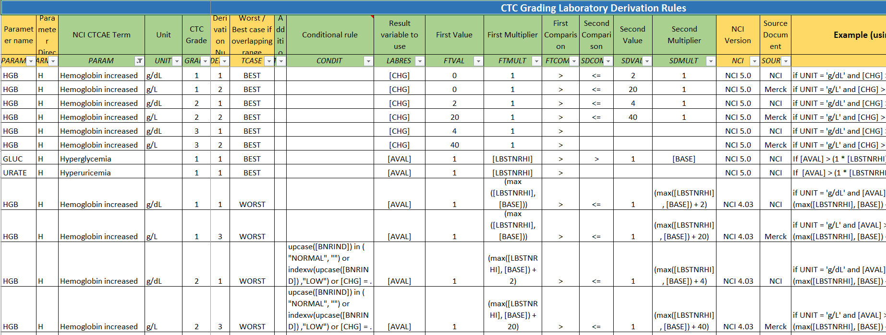
The technical definition file
The NCI CTCAE file is not possible to take as source for programming. It needs a human interpretation. SME created a technicl file which includes NCI 4.03 and NCI 5.0 versions.
Notes:
公司的该领域的专家编制了definition file，规则统一清晰，解决了前述问题。
可以看到对应于每一种labtest，都有公司的标准单位；如果tox grade overlap需要如何decide，取best还是worse；以及分解为最小单元的方便编程的conditions。
在这个definition file的基础上，通过编程来计算toxicity grade才是可行的。我的工作也是从这里开始

Slide 7
Main consideration and solution

Slide 8
Main consideration and solution
Problem to solve
Apply each rule in definition file on each record of lab data
Consideration
Definition file may change or update over time, so solution should be metadata driven
Should avoid nested loop as much as possible
Solution
Generate R function per lab test/unit/NCI version; save those functions in a Rdata file
Each record of lab data corresponds to a certain R function
Call this function and derived high and low grade assigned back to input lab data
Different versions of Rdata file can be pointed to

Slide 9
Implementaion

Slide 10
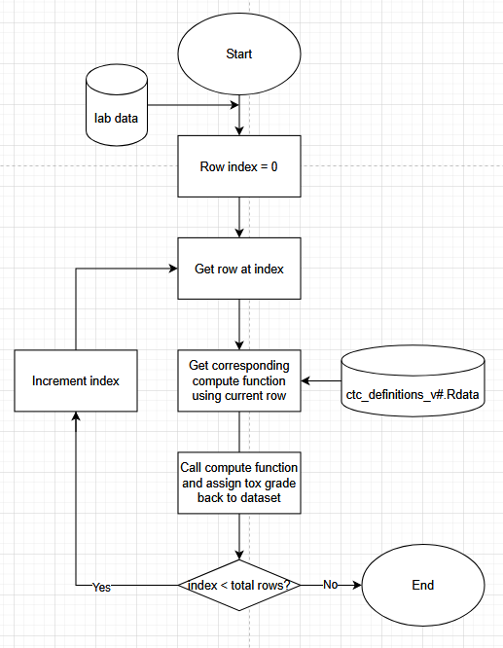
Over all process
If we ignore defensive code, the bone of
the main function is show in this flow chat

Slide 11
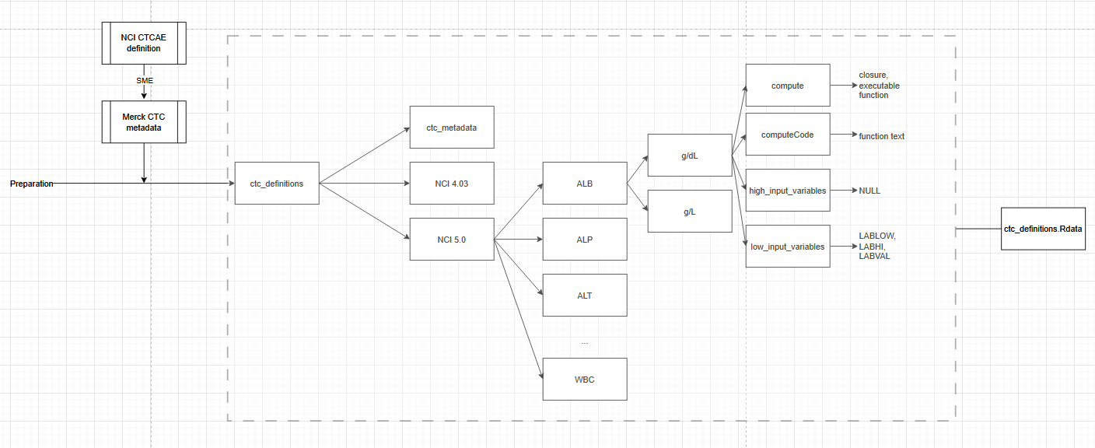
Convert definition file to Rdata file

Slide 12
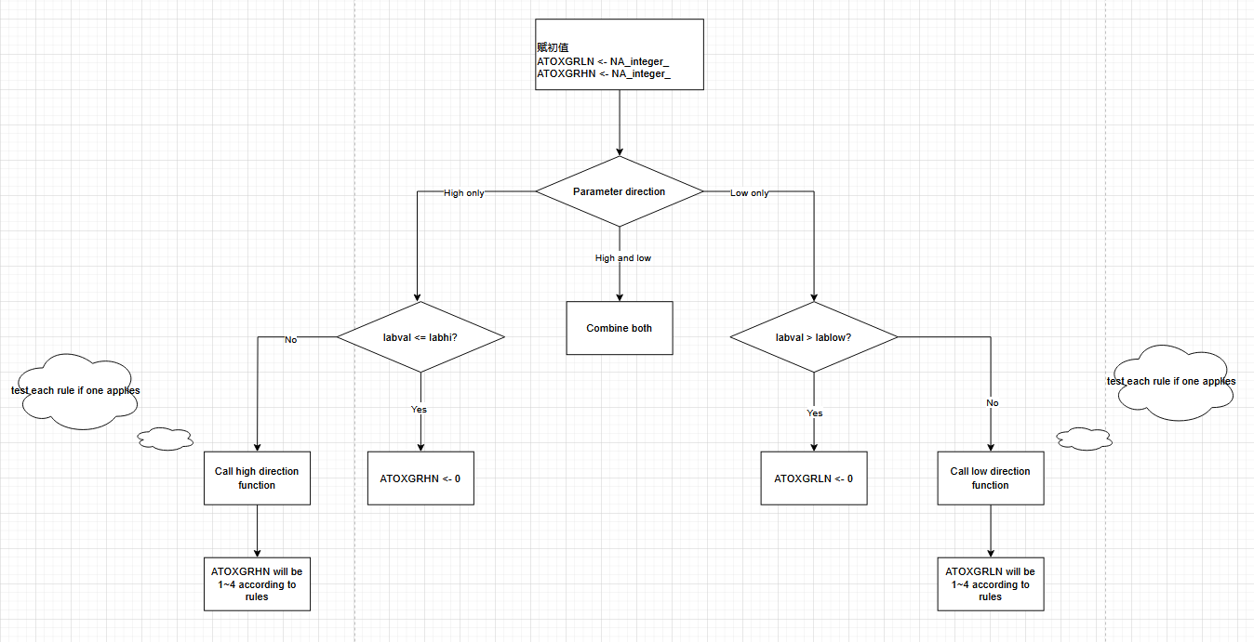
Compute function structure

Slide 13
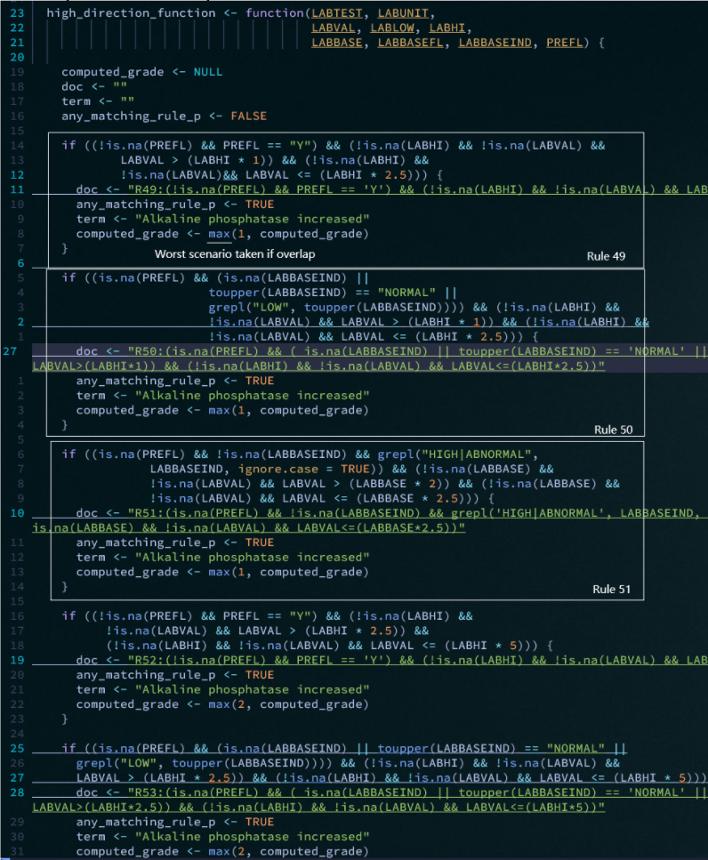
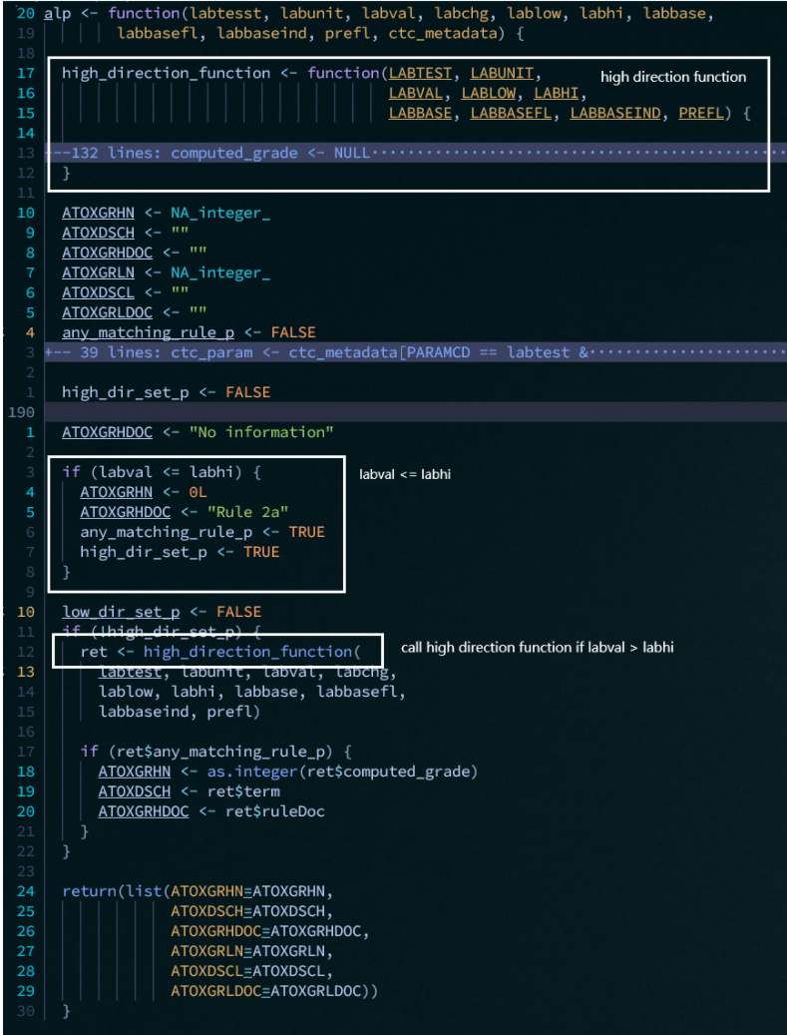
Example
ALP
Direction: high only
Preparation program generates alp function
Unit: NA
NCI version: 5.03
Best or worst score if overlap (worst for ALP->max)

Slide 14
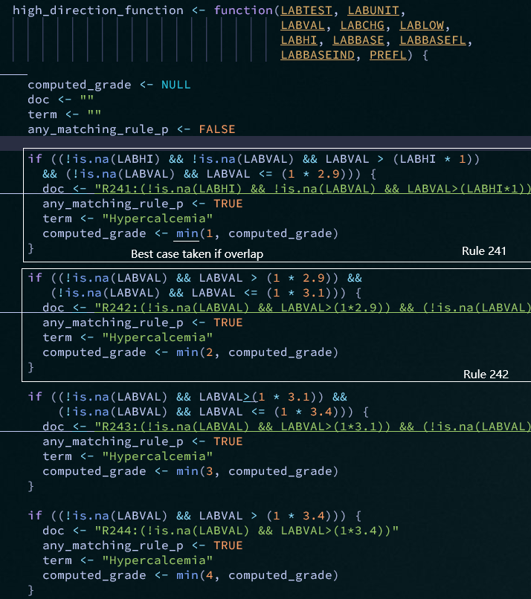
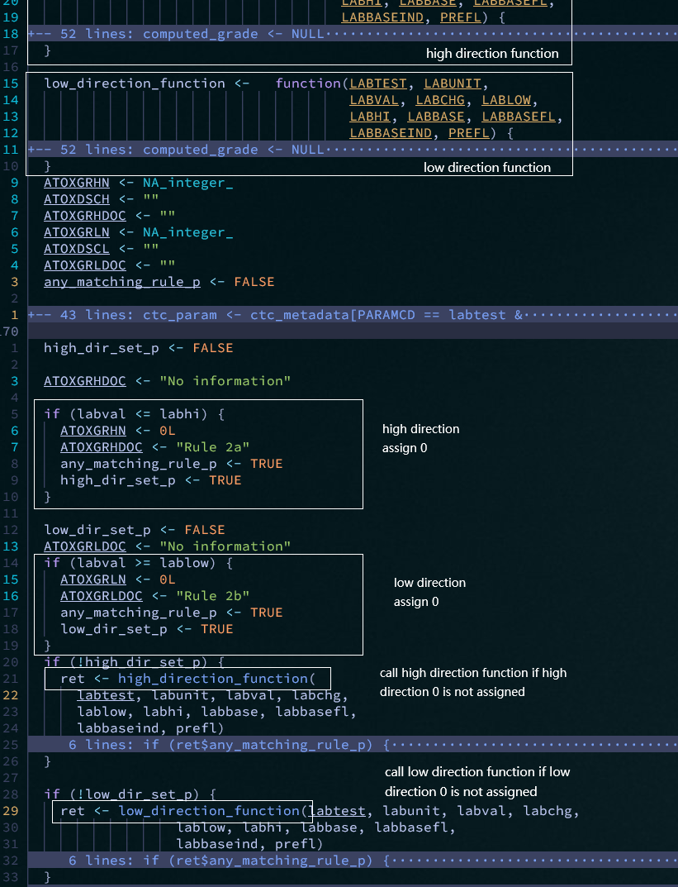
Example
CACRALB
Direction: both low and high
Preparation program generates cacralb function
Unit: mmol/L
NCI version: 5.0
Best or worst taken if overlap (best for CACRALB->min)

Slide 15
Limitations and possible improvements

Slide 16
Limitations and possible improvements
Limitations
Condition in definition file is SAS due to SME
Generation of R function is achieved by concatenating R code
Possible improvements
Language agnostic condition
Generate R function in a more “structural” way

Slide 17
Questions?
Questions?

